Slide 1
Genius Hour Day 1
_____________

Slide 2
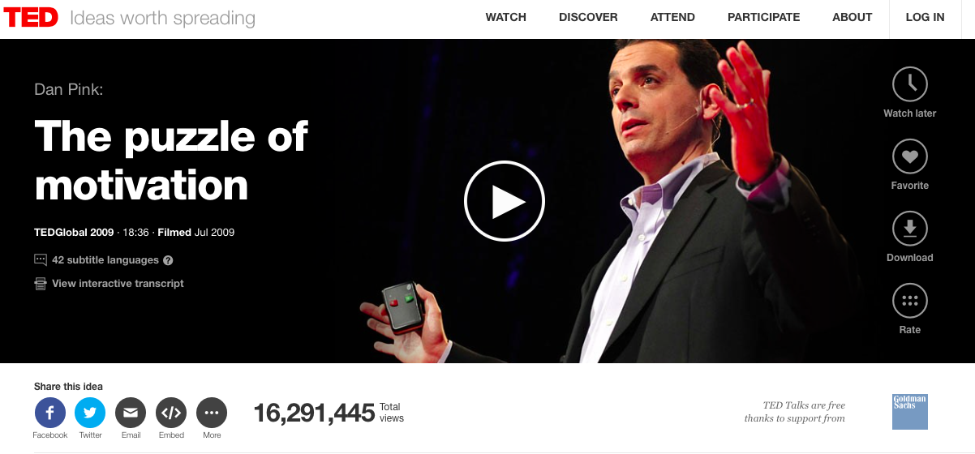
Watch Here: http://www.ted.com/talks/dan_pink_on_motivation?language=en

Slide 3
Thoughts About Learning
Are you motivated in school to learn?
Are you motivated to learn in your personal life outside of school?
When is the last time you had choice and purpose in your learning?

Slide 4
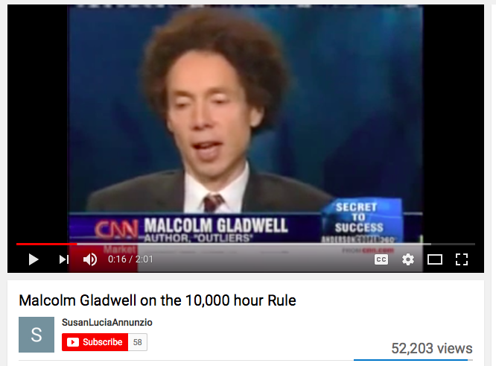
Watch Here: https://www.youtube.com/watch?v=XS5EsTc_-2Q

Slide 5
So, what's the point?
What is the connection between Google's 20% Time Policy and Dan Pink's Motivation Video?
What is the connection between Malcom Gladwell's 10,000 Hour Rule and Google's 20% Time Policy?

Slide 6
What is Genius Hour?
Your Passion
A Purpose
Time to Learn & Create
What’s Your Genius Hour: _________

Slide 7
Research on Genius Hour
How was the Post-It Note invented?
What did Google do that was so different than most companies?
What motivates us more than anything else?

Slide 8
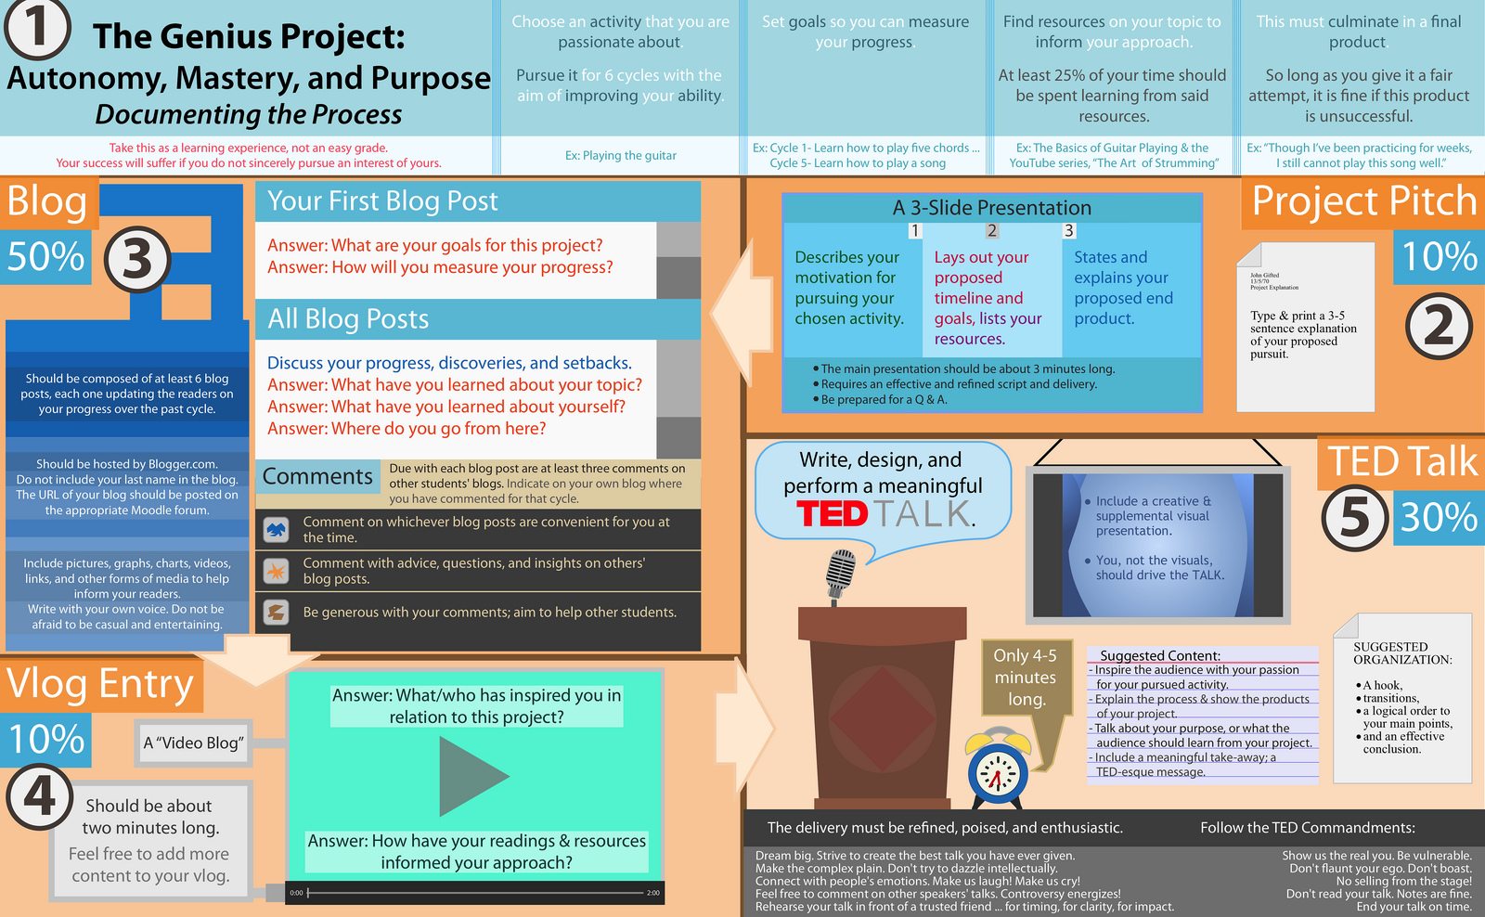
An Overview:
Genius Hour Project

Slide 9
What are you passionate about?
What do you do for fun?
What are you curious about?
What have you always wanted to make or create or do?

Slide 10
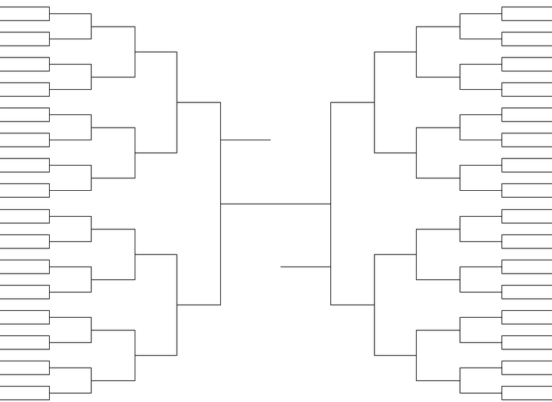
The Passion Madness Bracket Challenge

