Slide 1
Genius Hour Day 2
_____________

Slide 2
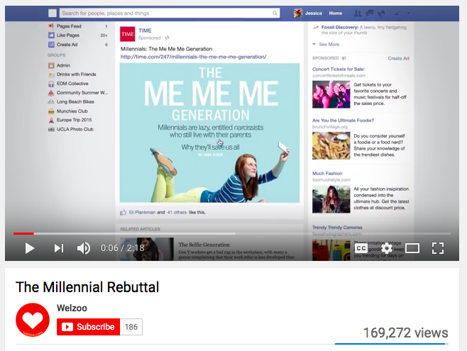
Watch Here: https://www.youtube.com/watch?v=dZP-owj7flQ

Slide 3
Changing The World?
Are you interested in changing the world? What would you change?
Is their a product that has changed your life?
Is there a movement you'd like to start or support?

Slide 4
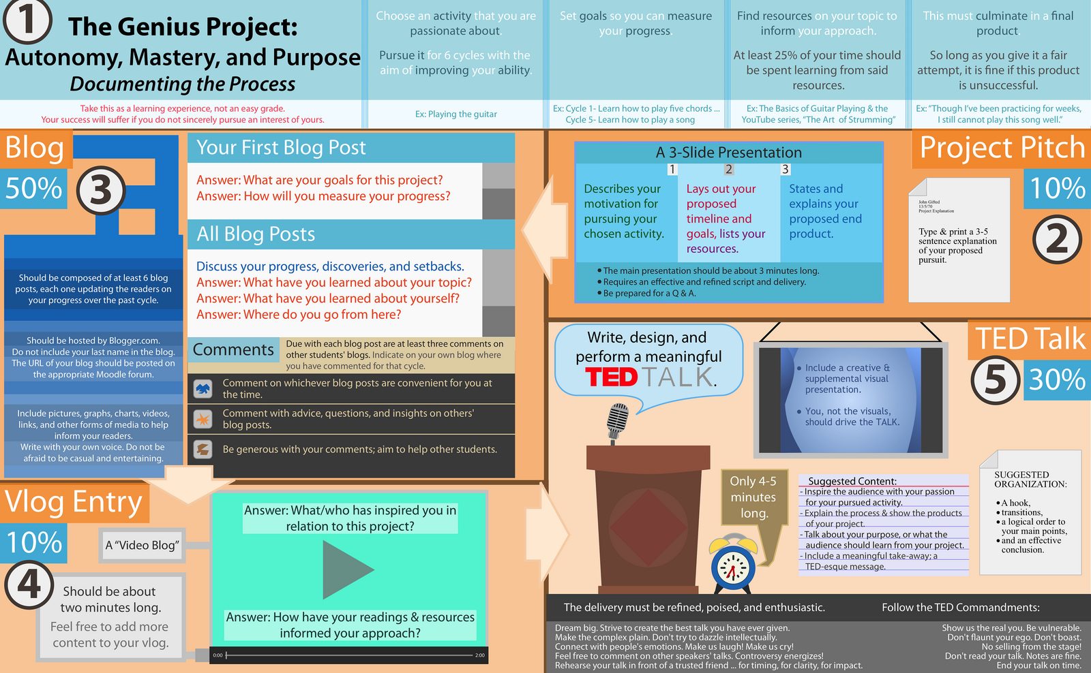
An Overview:
Genius Hour Project

Slide 5
KWL Topic:_______________
What you KNOW
What you WANT
to know
What you
LEARNED

Slide 6
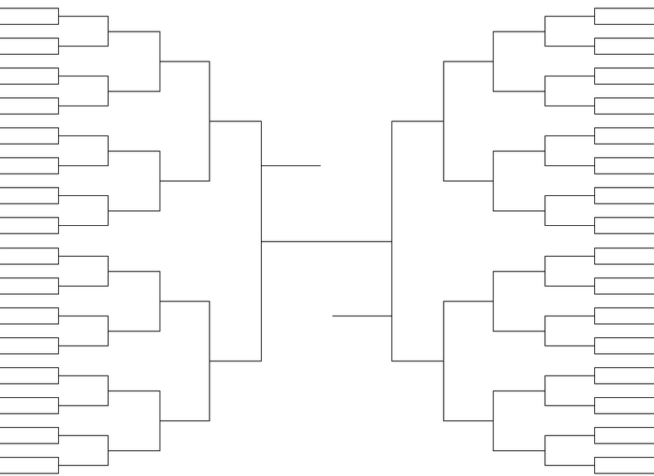
The Passion Madness Bracket Challenge

Slide 7
Shark Tank Pitch: Share With The Class
(Example)
-Learn to code/program
-Create a video game for elementary students
WHAT
-I’m passionate about gaming and want to learn the process behind the scenes
WHY
Online tutorials
Code mentor
Prototype a game using Scratch
Publish the game for others to play
HOW
100 people play my game
SUCCESS

Slide 8
Shark Tank Pitch: Share With The Class
WHAT
WHY
HOW
SUCCESS

Slide 9
Shark Tank Pitch: Share With The Class
WHAT

Slide 10
Shark Tank Pitch: Share With The Class
WHY

Slide 11
Shark Tank Pitch: Share With The Class
HOW

Slide 12
Shark Tank Pitch: Share With The Class
SUCCESS

