Slide 1
The Genius Hour Journal
_____________

Slide 2
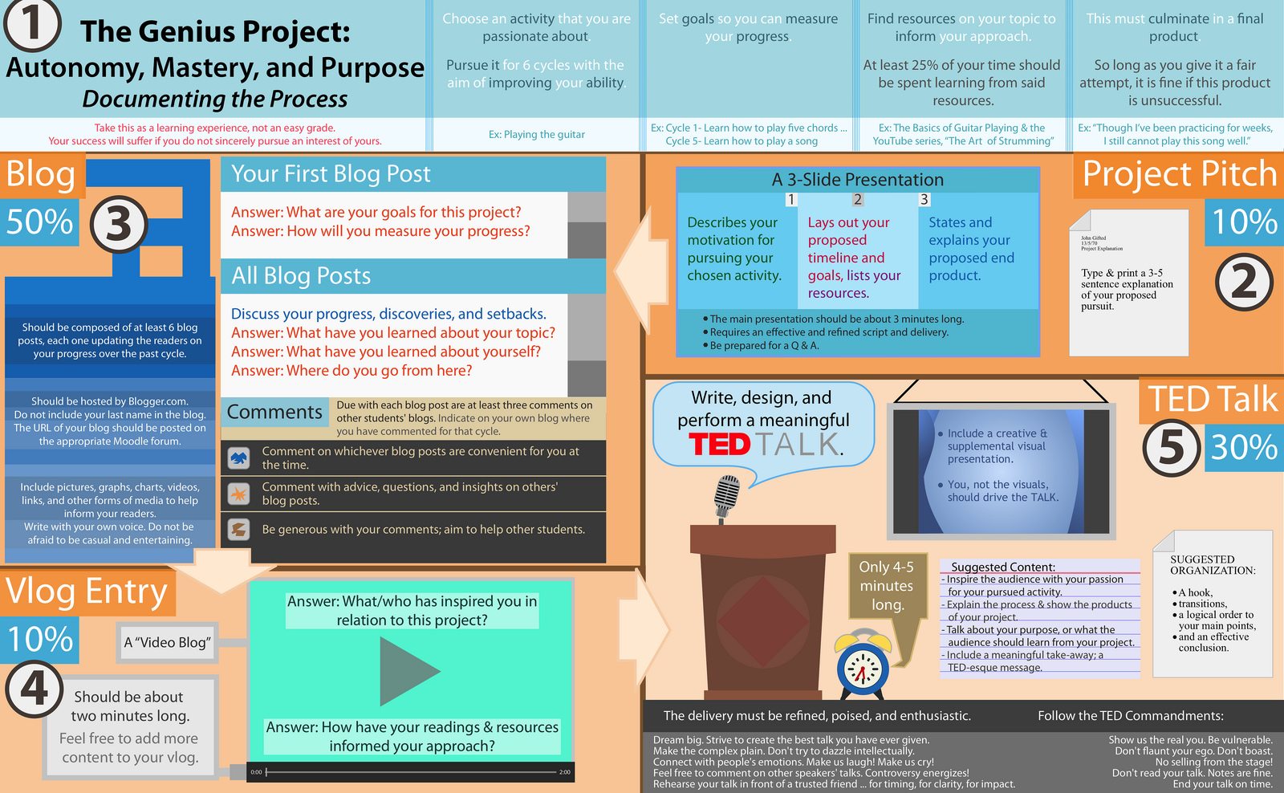
An Overview:
Genius Hour Project

Slide 3
KWL Topic:_______________
What you KNOW
What you WANT
to know
What you
LEARNED

Slide 4
Shark Tank Pitch: Share With The Class
WHAT
WHY
HOW
SUCCESS

Slide 5
Genius Hour Double-Entry Journal
What did you learn?
What did you make/create?
Epic Failures ☺
Goal For Next Time
Did you accomplish
Last week’s goal?
Why/why not?

Slide 6
Genius Hour Double-Entry Journal
What did you learn?
What did you make/create?
Epic Failures ☺
Goal For Next Time
Did you accomplish
Last week’s goal?
Why/why not?

Slide 7
Progress Meter: How Many Hours At Each Step
Present
Idea
Pitch
Create
Learn
Reflect

Slide 8
Giving A Great Talk: Presentation Structure
The Problem
(What you want to learn)
The Solution: What Could Be?

Slide 9
Giving A Great Talk: Presentation Structure
Learning Struggles
Learning Wins!

Slide 10
Giving A Great Talk: Presentation Structure
What You Made
Rewards For
Learning/Making

Slide 11
Giving A Great Talk: Presentation Structure
The Solution: What Could Be?
Learning Wins!
The Problem
(What you want to learn)
Learning Struggles
Reward For Learning/Making
What You Made
Reflection
What’s Next?

Slide 12
What I Learned…
What did I struggle with and how did I learn from it?
What was the most exciting part of Genius Hour? Why?
What do I want to learn/do/make/create next?

